Slide 1


EC2 Part 2
Sameer Zulfi

Slide 2
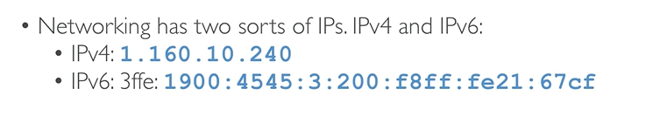
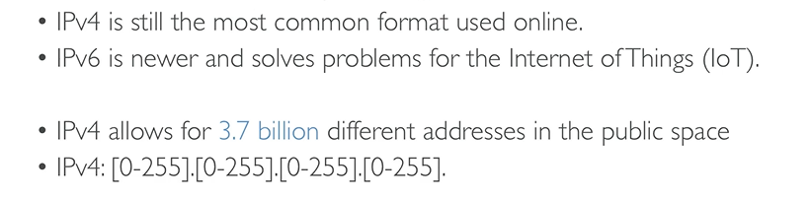
Private vs Public IP Basics

Slide 3
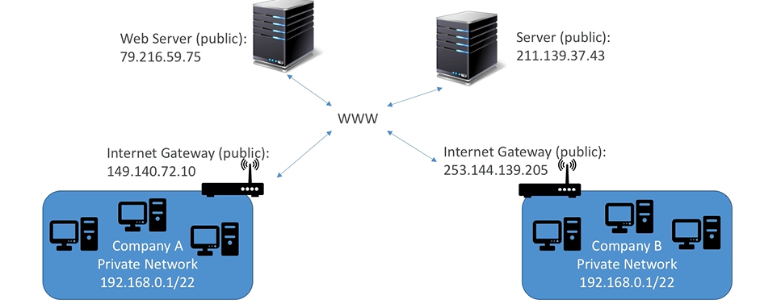
Private vs Public IP

Slide 4
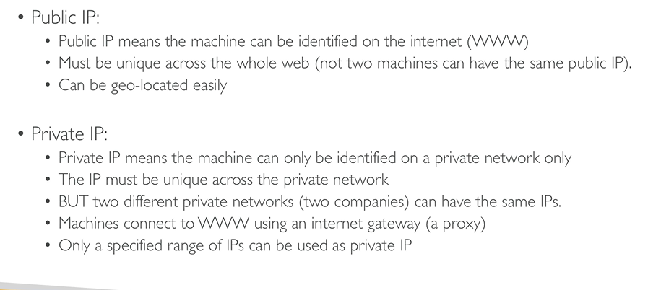
Public vs Private IP

Slide 5
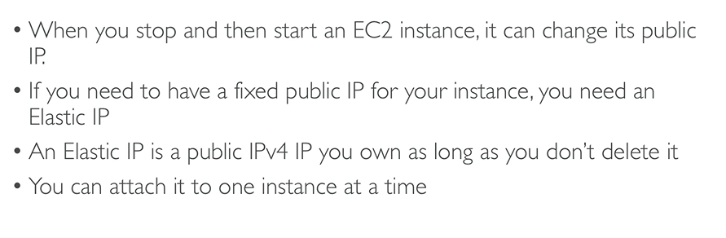
Elastic IP

Slide 6
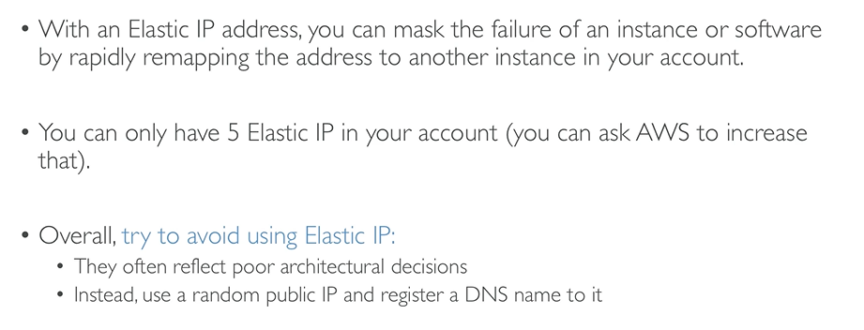
Elastic IP

Slide 7
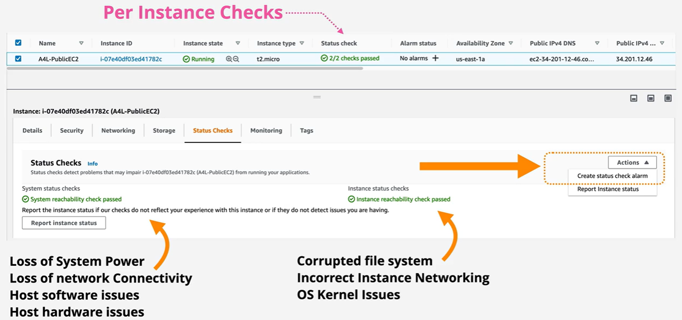
Instance Status Checks

Slide 8
ShutDown, Terminate and Terminate Protection

Slide 9
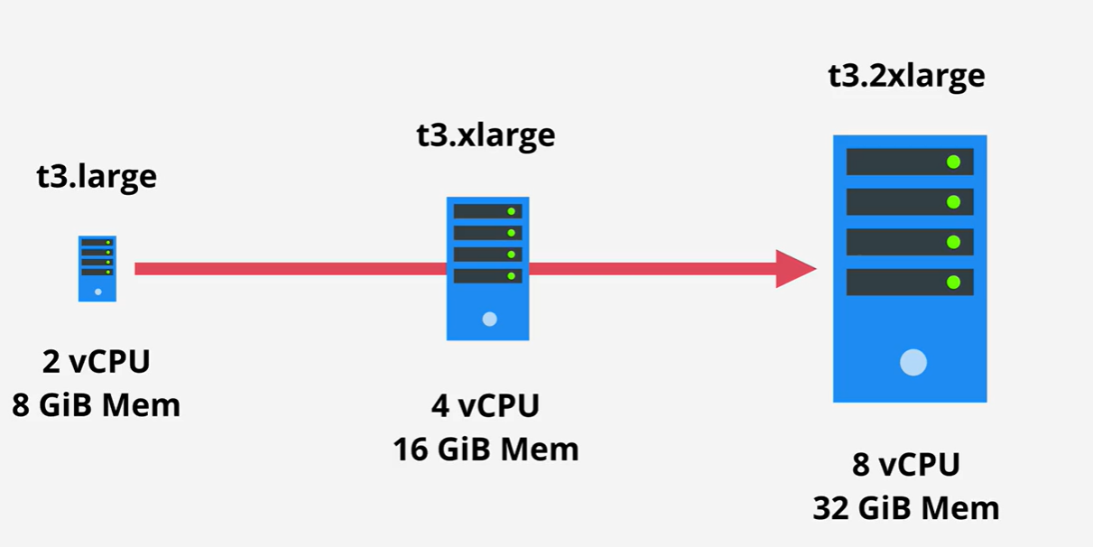
Horizontal & Vertical Scaling
Vertical Scaling

Slide 10
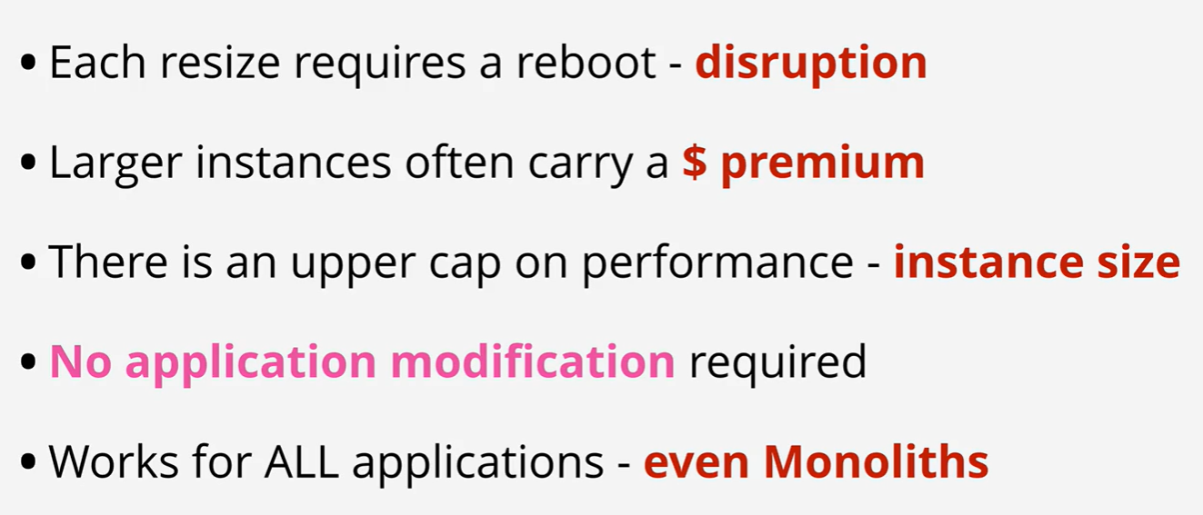
Vertical Scaling

Slide 11
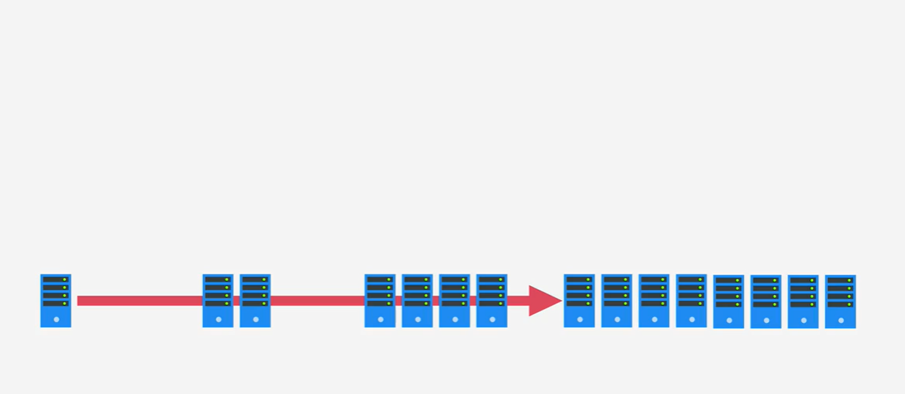
Horizontal Scaling

Slide 12
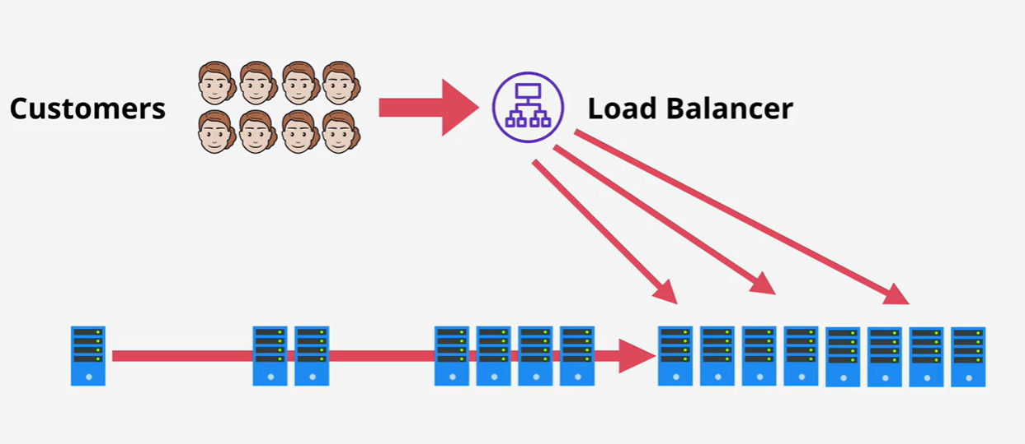
Horizontal Scaling

Slide 13
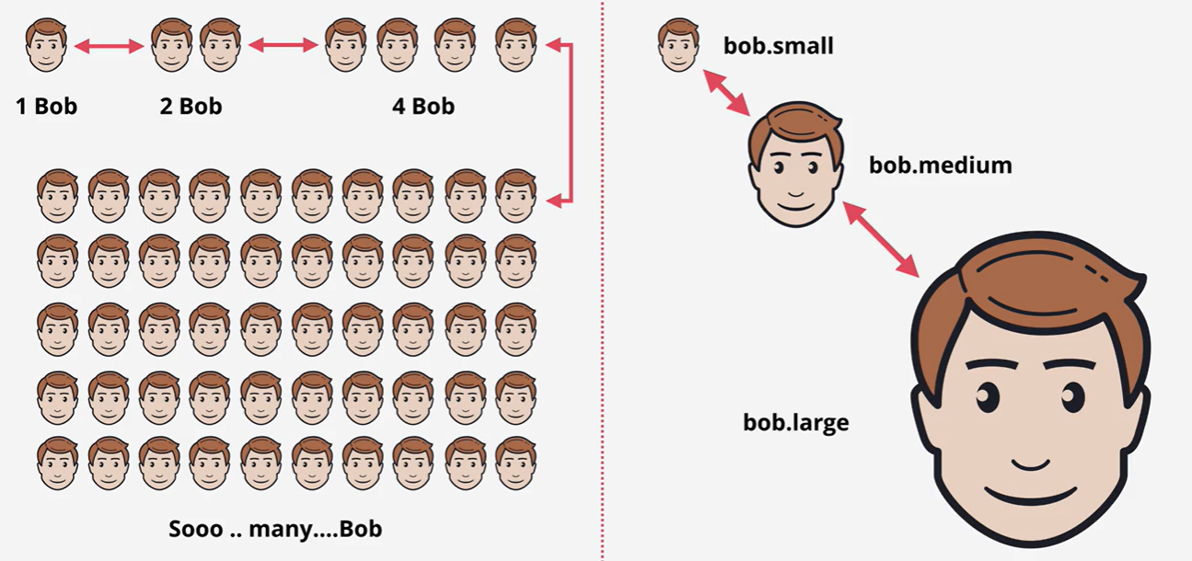
Which is ?

Slide 14
Instance Metadata
http://169.254.169.254/latest/meta-data/public-ipv4
http://169.254.169.254/latest/meta-data/public-hostname
Wget http://s3.amazonaws.com/ec2metadata/ec2-metadata
Ls –la
Chmod u+x ec2-metadata
./ec2-metadata –help
./ec2-metadata –a
./ec2-metadata –z
./ec2-metadata –s

Slide 15
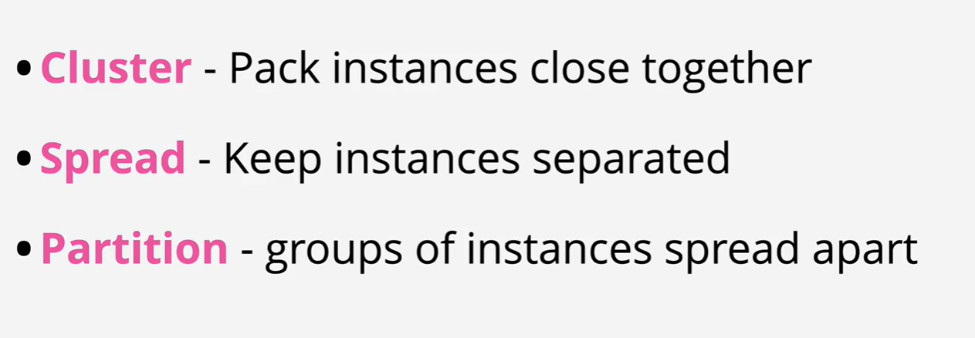
EC2 Placement Groups

Slide 16
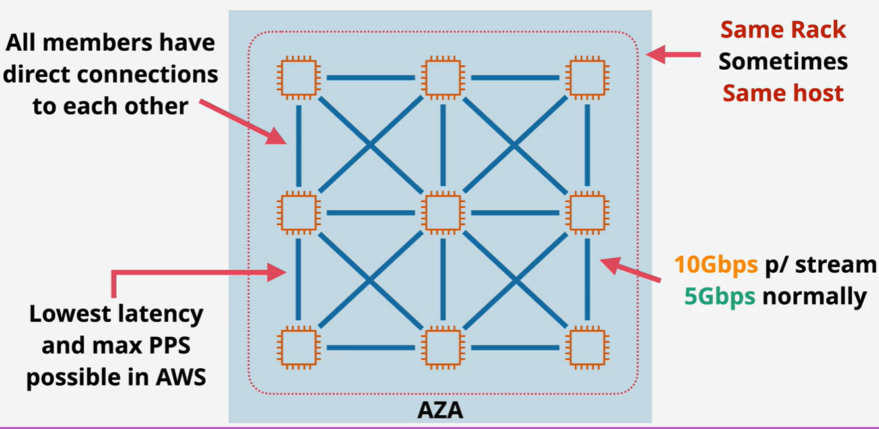
Cluster Placement Group

Slide 17
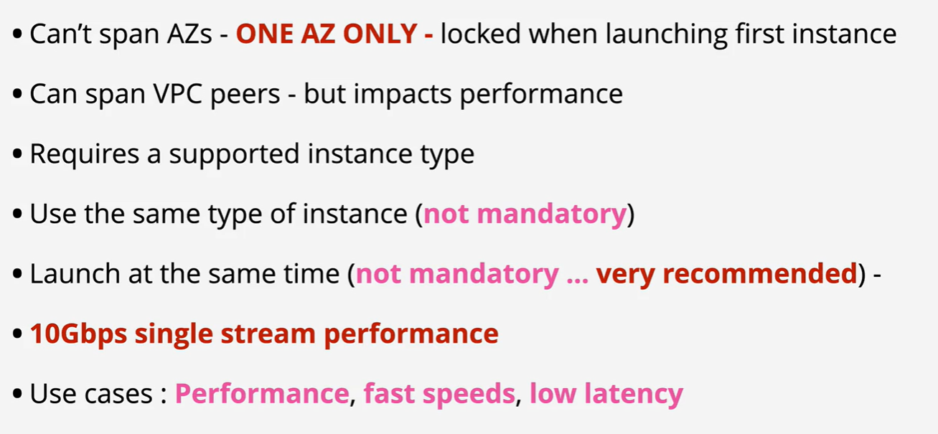
Cluster Placement Group

Slide 18
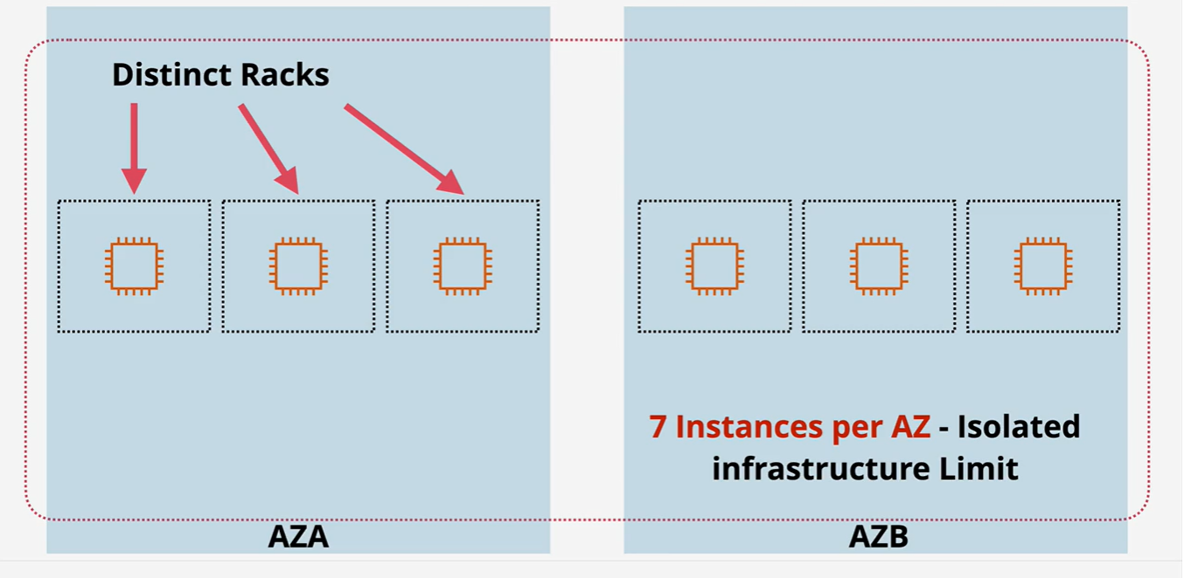
Spread Placement Groups

Slide 19
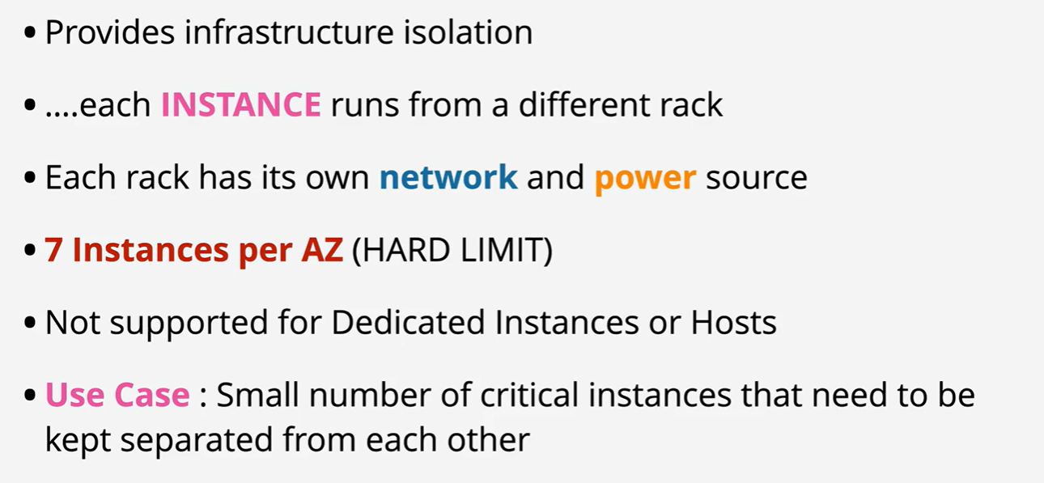
Spread Placment Groups

Slide 20
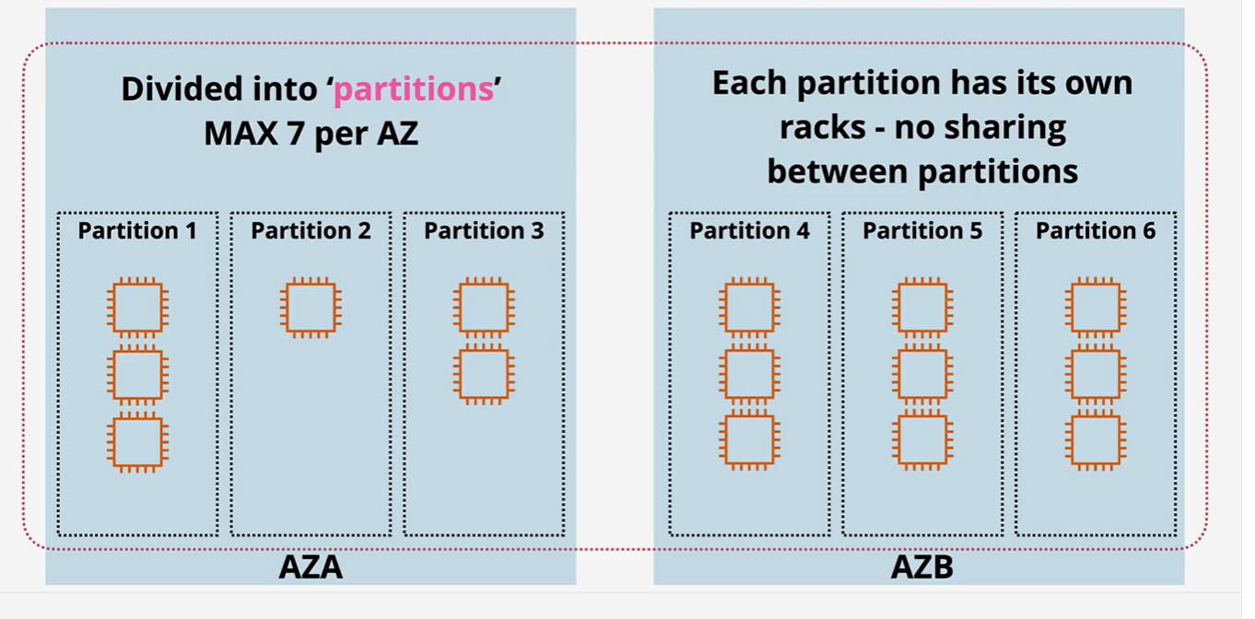
Partition Placement Groups

Slide 21
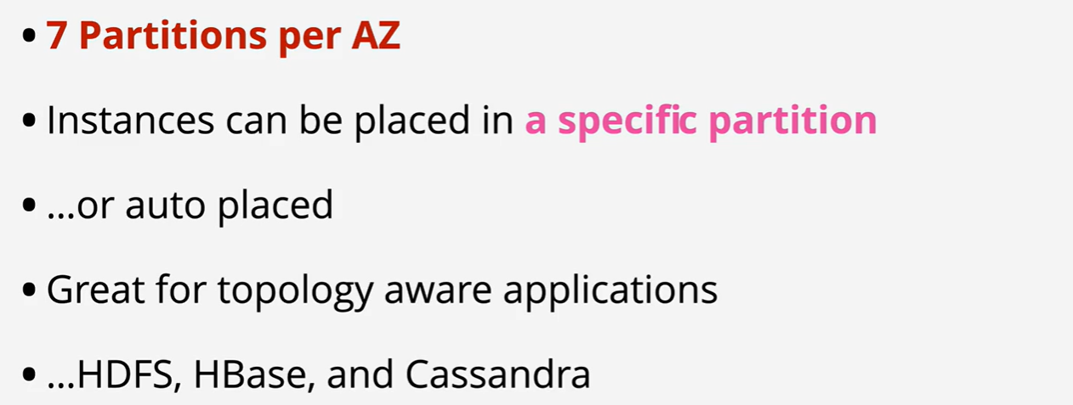
Partition Placement Groups

Slide 22
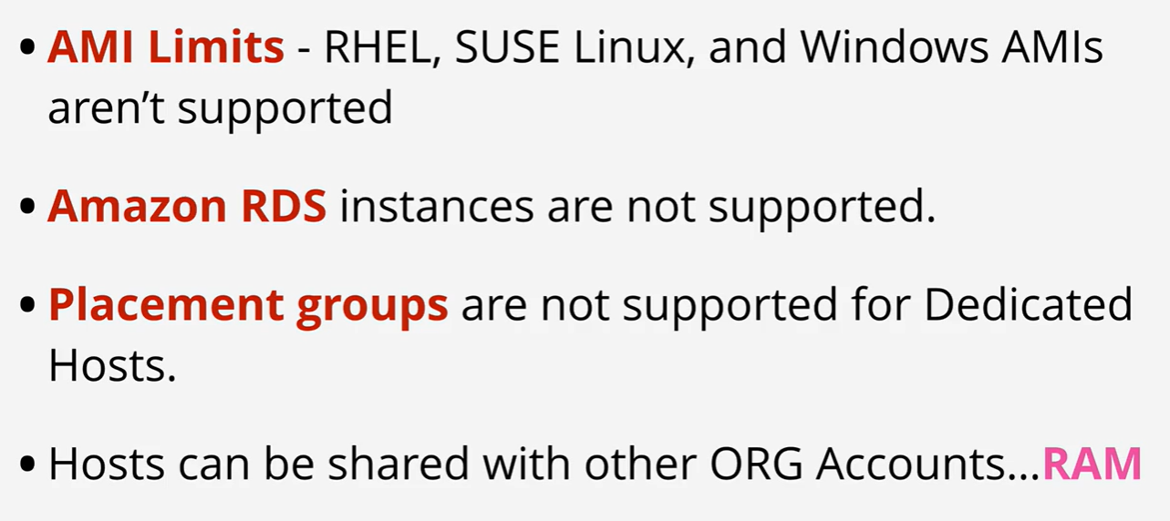
Dedicated Host - Limitations

